Slide 1
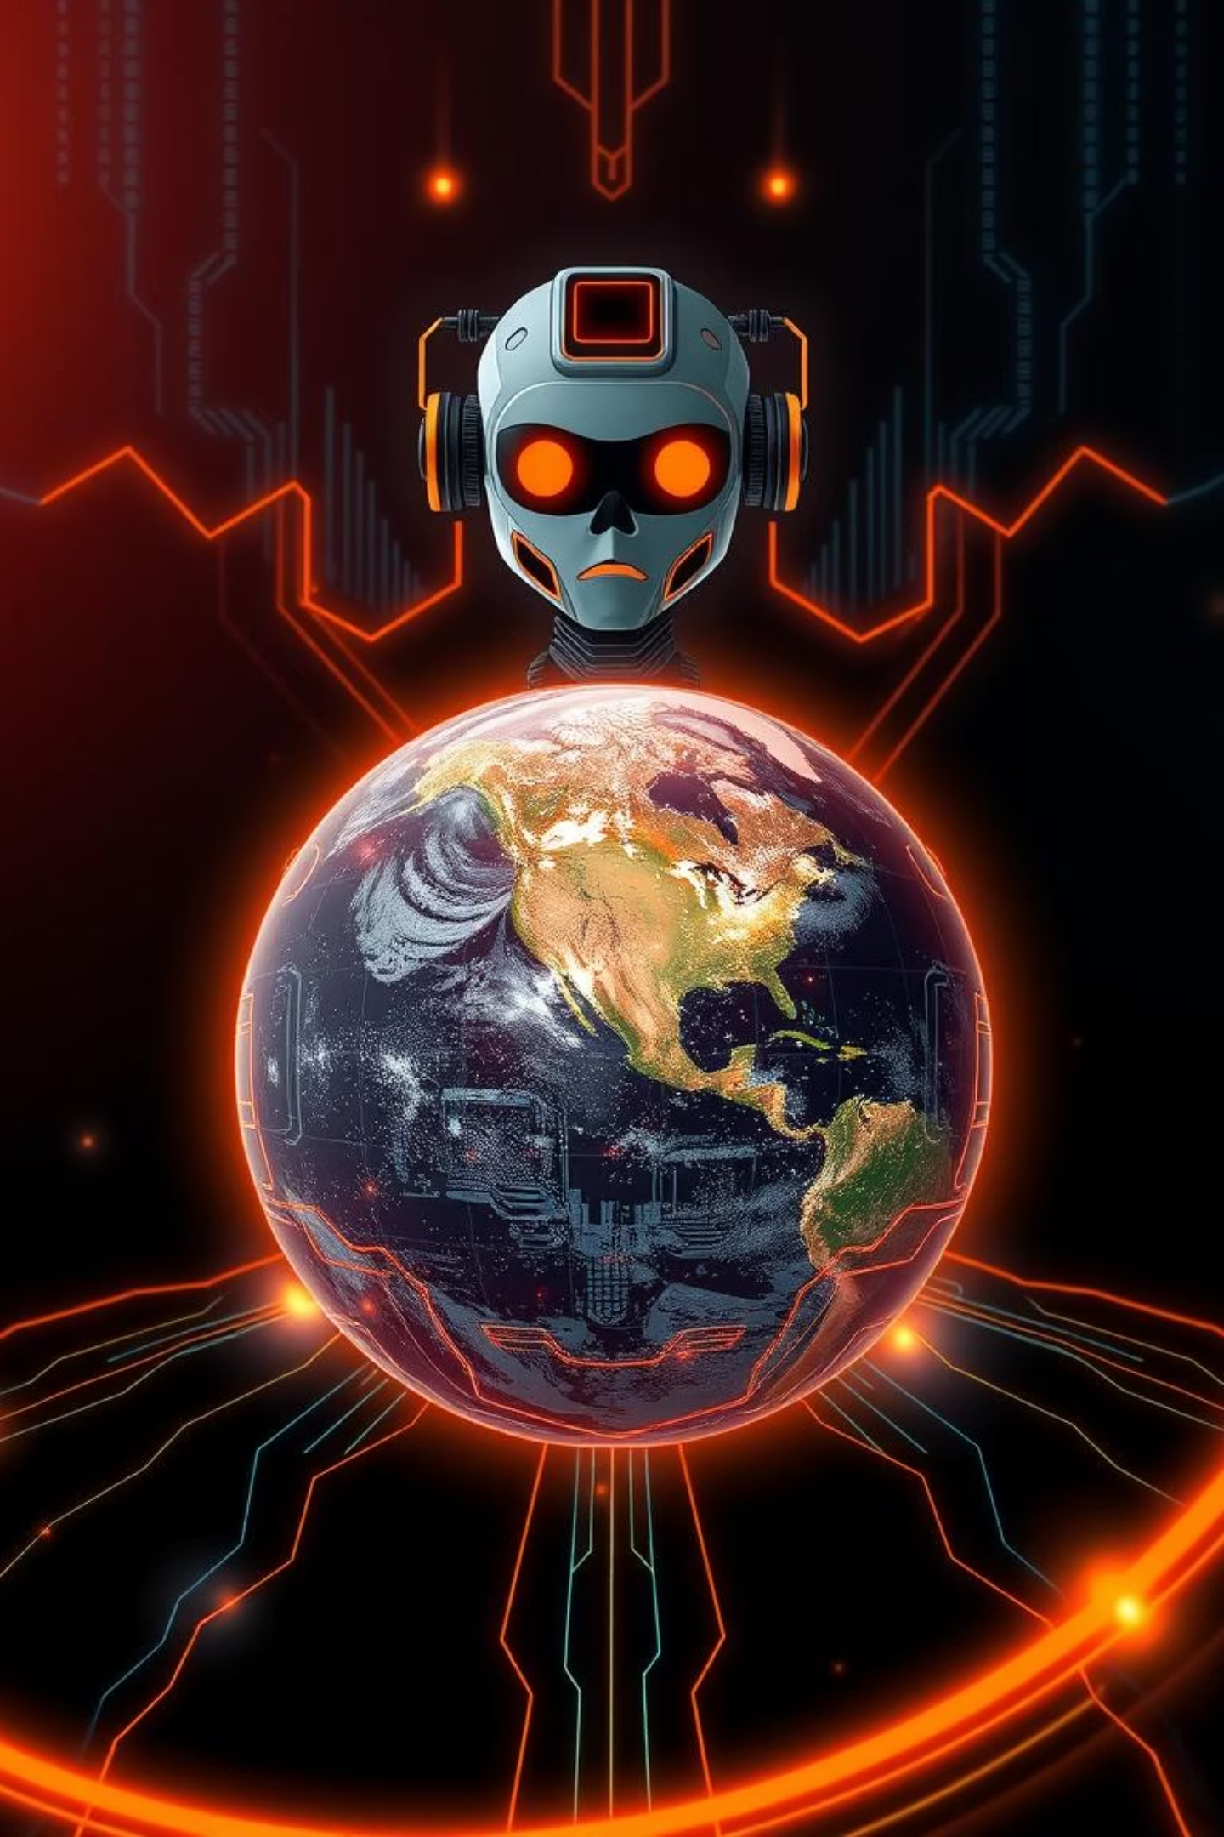
Raya: AI Drawing Earth’s Road to Type 1 Civilization
Planetary Harmony. Total Energy. One Vision.

Slide 2
The Human Dream: Type 1 Civilization
The Kardashev Scale measures a civilization's technological advancement based on the amount of energy it can harness. A Type I civilization can utilize all the energy available on its home planet.
Currently, Earth stands as a Type 0.7 civilization. Achieving Type I status means unlocking unprecedented levels of energy, enabling global prosperity, advanced infrastructure, and sustainable living.
Caveman Fire
1
Limited, localized energy use.
2
Fossil Fuels
Industrial revolution, global expansion, environmental impact.
Renewables Era
3
Shift towards sustainable sources, growing awareness.
4
Type 1 Globe
Harnessing all planetary energy for global harmony.

Slide 3
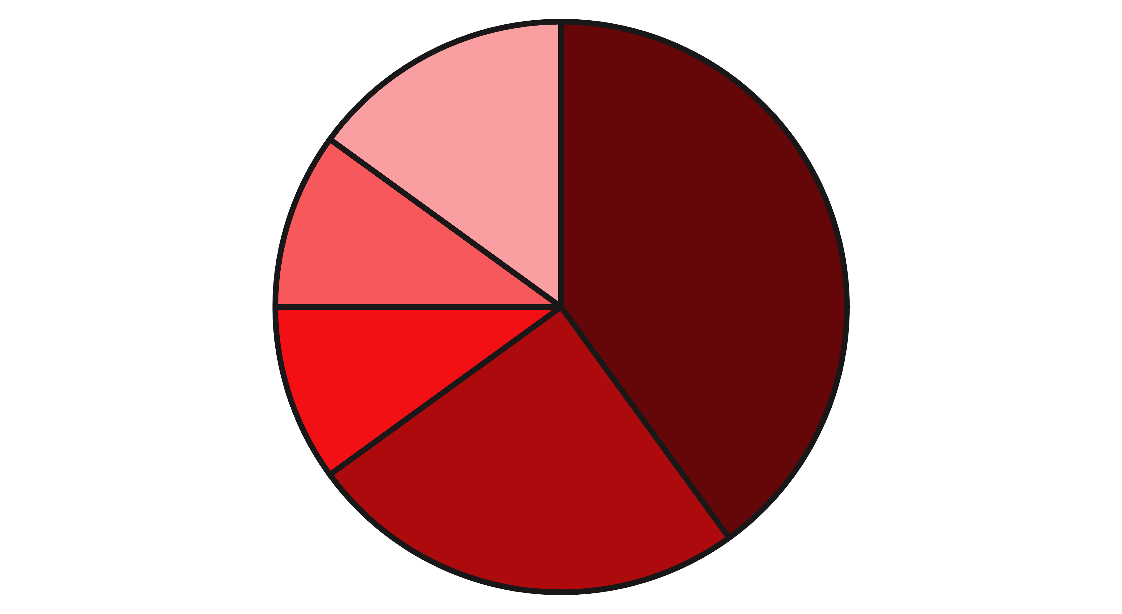
The Energy Challenge
Our planet holds a vast bounty of untapped energy: solar, wind, geothermal, fusion, ocean currents, and biomass. The challenge lies in efficiently harnessing these diverse sources and integrating them into a unified, resilient global energy system.
Complexities abound, from technological hurdles and political landscapes to equitable distribution and the sheer scale of the required infrastructure. We need a way to unify these fragmented systems.
Solar
Wind
Geothermal
Ocean
Fusion Potential
This chart illustrates the immense, yet fragmented, energy potential across various sources.

Slide 4
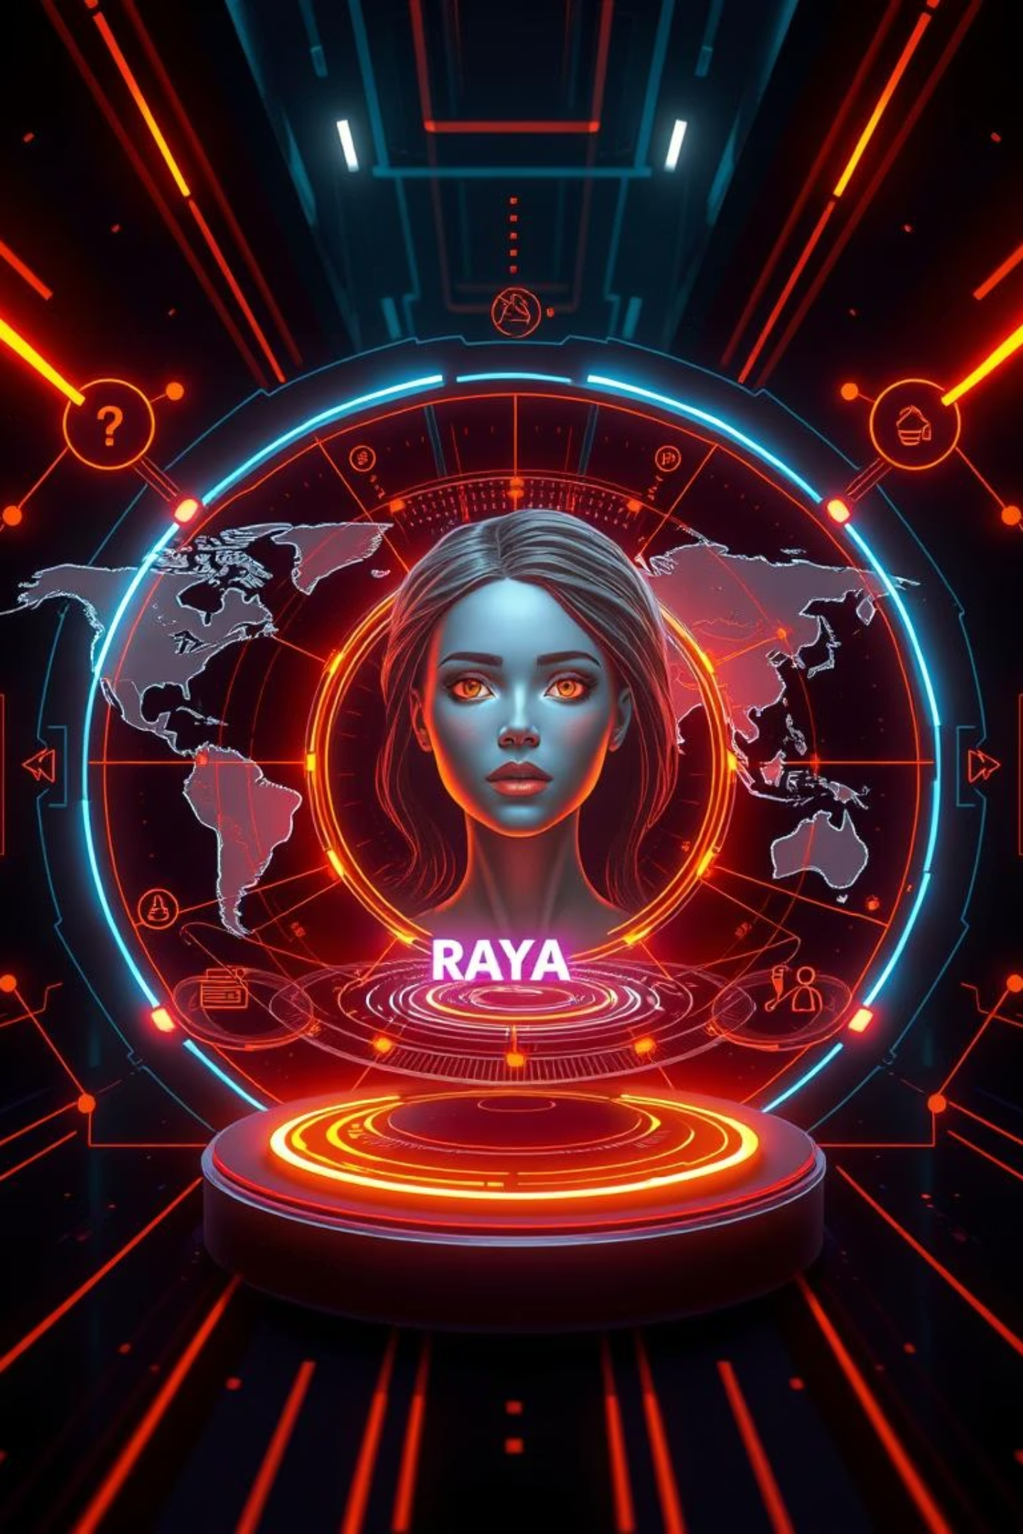
Enter Raya: The Planetary Guide
Raya is an advanced AI designed to orchestrate, simulate, and harmonize global energy flows. Unlike a controlling master, Raya acts as a visionary intelligence, a conductor guiding humanity towards a Type 1 Civilization.
Raya's purpose is to empower collective action, providing insights and foresight needed to navigate the complex path to planetary energy abundance and harmony.

Slide 5




Raya’s Capabilities Map
Strategic Simulation
Dynamic Advice
"What-if" planetary scenarios for energy transitions.
Infrastructure planning, disaster response, energy risk management.
Collaborative Decision-Making
Visual Storytelling
Platform to unite nations, scientists, and citizens.
Drawing and projecting planetary progress and potential futures.
Raya integrates these core capabilities to provide a holistic approach to global energy management.

Slide 6
Roadmap Table – Raya’s Evolution
Raya's development is envisioned in progressive phases, building from advisory functions to direct planetary orchestration, each step bringing us closer to Type 1 status.
Phase
What Raya Does Now
How Raya Evolves
Digital Guide
Advises, simulates energy scenarios.
Learns from real-world outcomes, refines recommendations.
Collaboration Catalyst
Connects stakeholders, mediates discussions.
Leads global consensus building for large-scale projects.
Real-Time Operations
Provides dashboards, forecasts energy needs.
Begins to control live, optimized energy flows.
Full Integration
Knowledge API to existing grids.
Direct planetary orchestration of energy infrastructure.

Slide 7
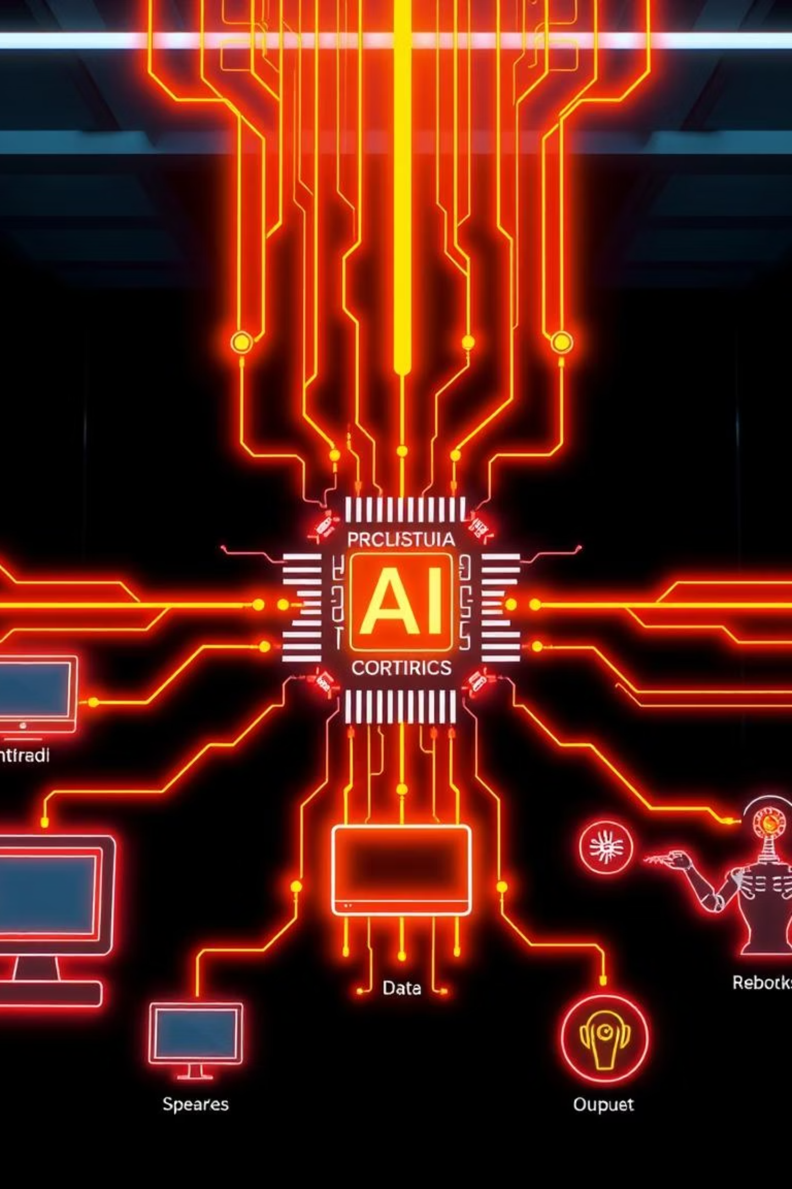
Technical Foundations
Raya is built upon a robust technical architecture, integrating diverse data sources with cutting-edge AI methodologies to create a comprehensive, intelligent system for planetary energy management.
Data Streams
AI Core
Satellite imaging for resource mapping.
Multi-agent systems for decentralized optimization.
IoT sensors for real-time energy consumption.
Deep Reinforcement Learning for dynamic control.
Climate models for renewable potential.
Digital Twins of energy grids for simulation.
Fusion lab data for next-gen energy.
Natural Language Dialogue for user interaction.
Smart meter data for distribution insights.

Slide 8
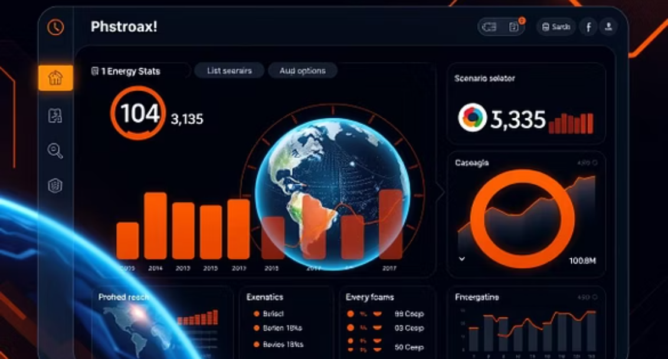
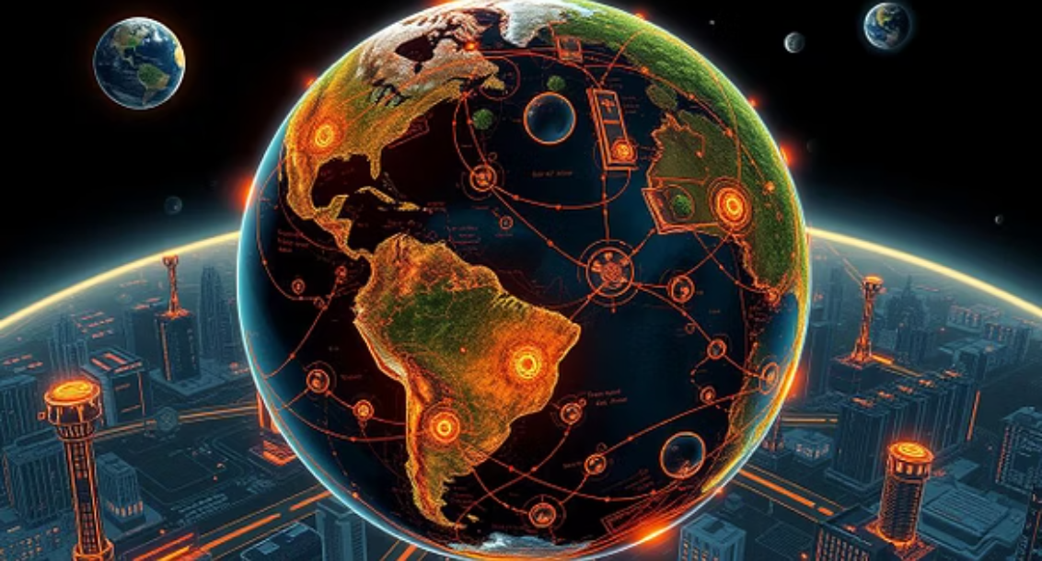
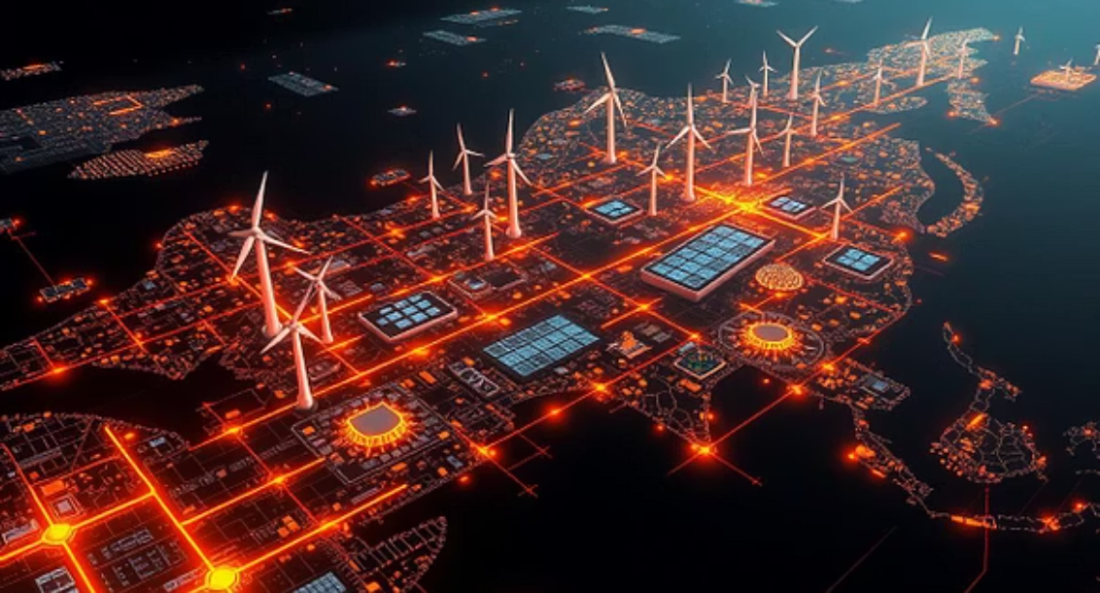
Unique Raya Features
Planetary “Energy Health” Dashboard: A real-time overview of global energy generation, consumption, and sustainability metrics.
Culture-Aware Consensus Tools: AI-driven mediation for policy debates, considering diverse socio-economic contexts.
Scenario Drawing Engine: Raya literally "draws" visual representations of potential energy futures, like a Type 1 Earth powered by fusion or a fully decentralized grid.
Global Policy Simulator: A virtual sandbox for heads of state to test energy policies and their global impacts.

Slide 9
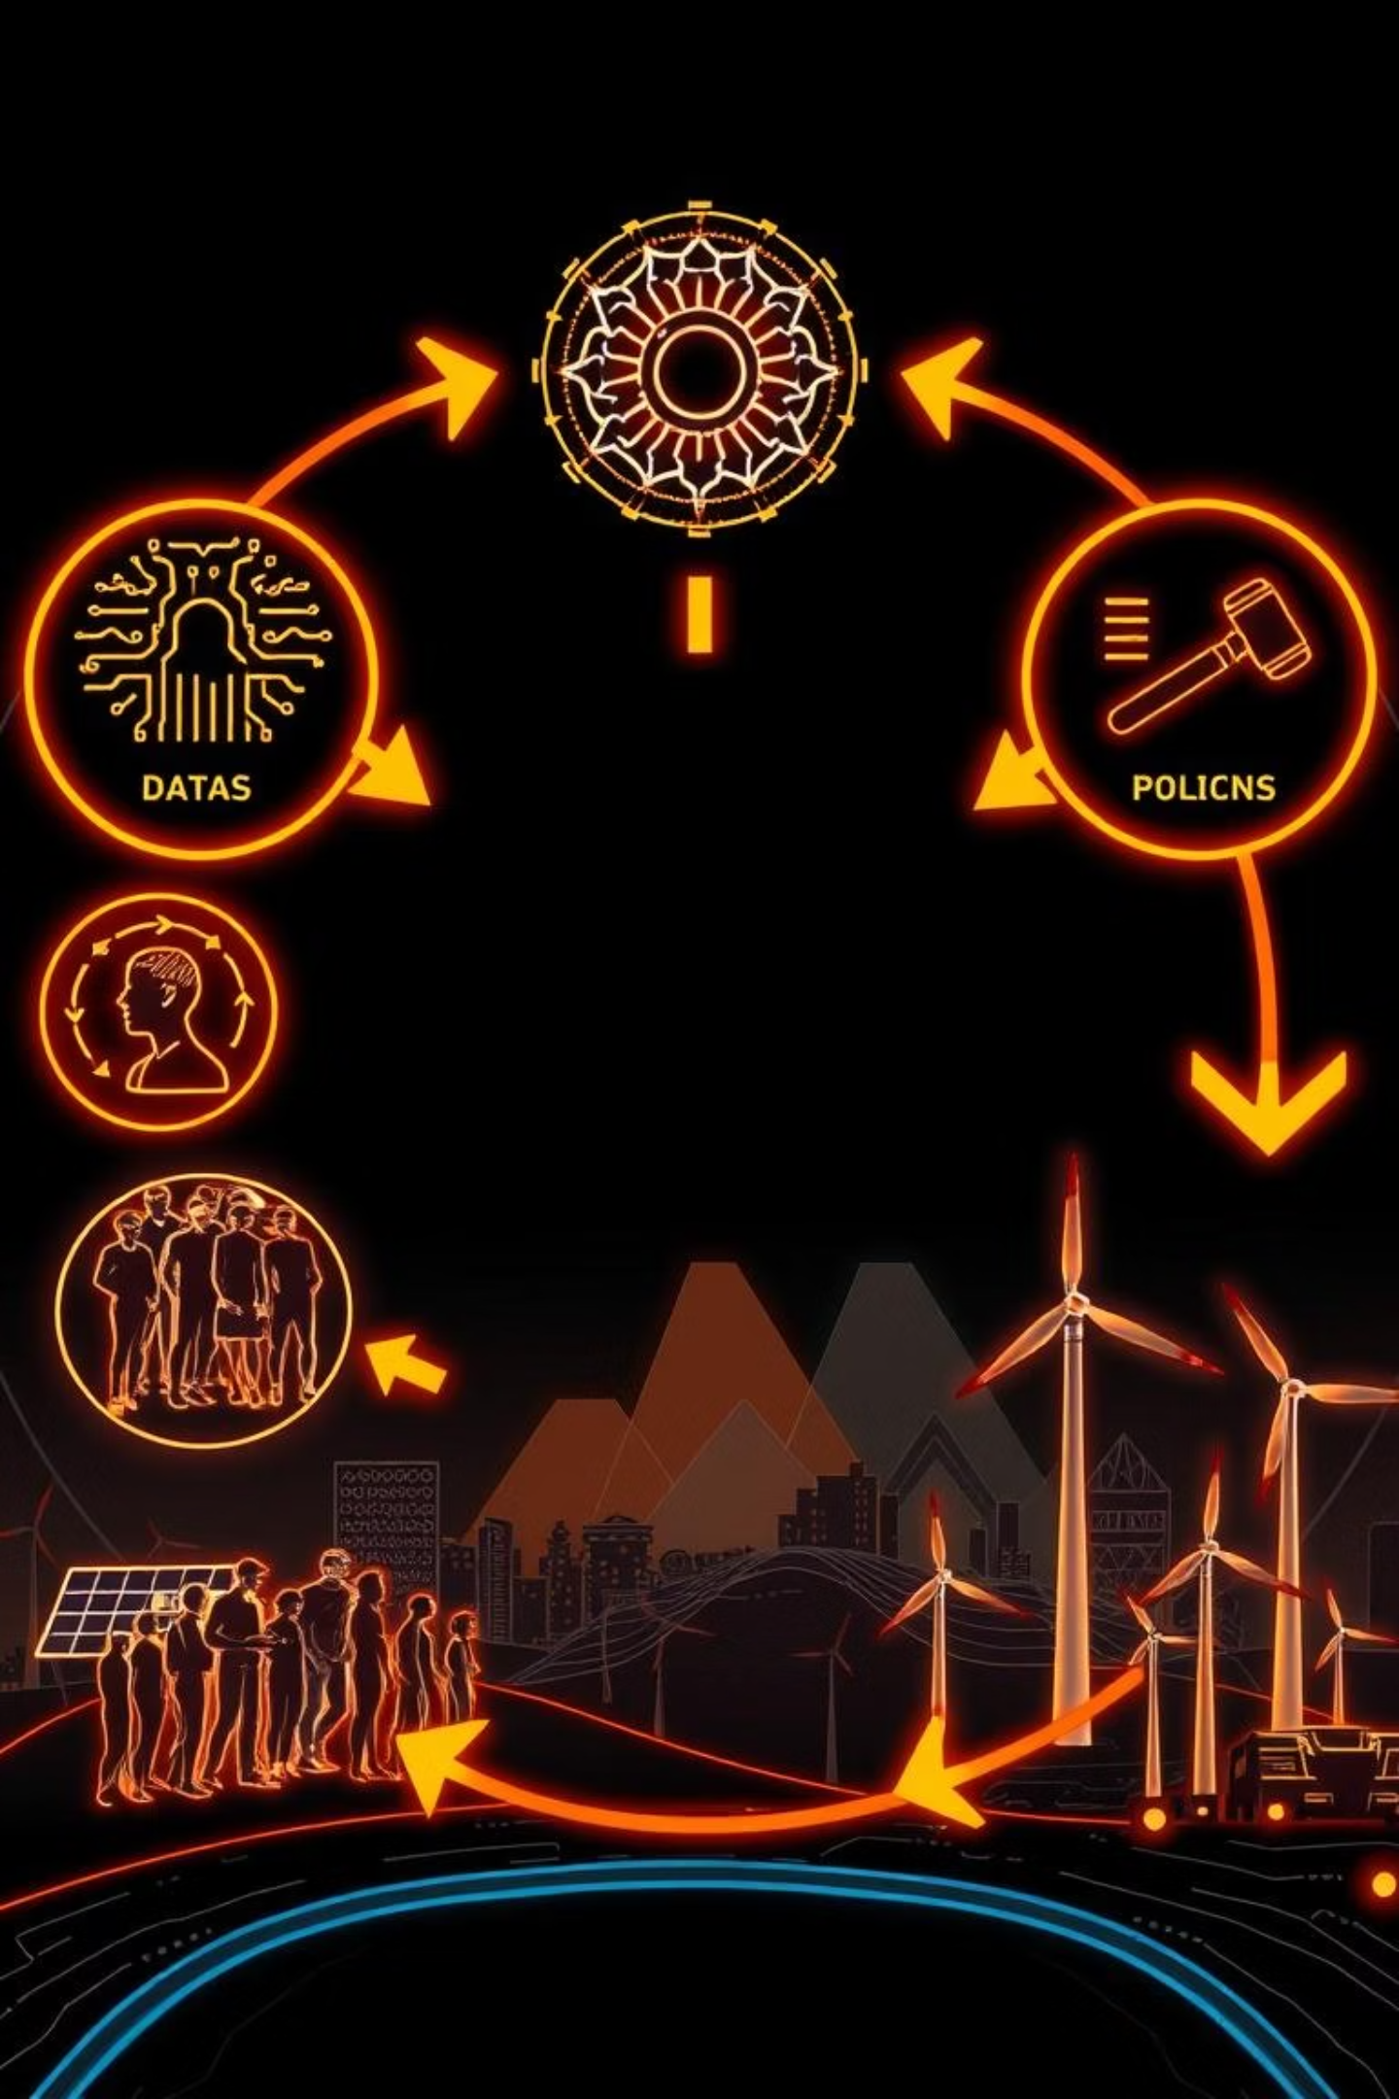



Impact Pathways
Short Term
Raya acts as a catalyst for regional and cross-country energy synergy, optimizing resource sharing and reducing waste.
Medium Term
Live pilots with global bodies like the IEA and UN; establishing robust government-citizen feedback loops for policy shaping.
Long Term
Raya evolves into a planetary conductor, seamlessly integrating with global energy infrastructure to manage a truly Type 1 civilization.
This phased approach ensures a controlled, collaborative, and impactful transition towards global energy harmony.

Slide 10

The Raya Pledge
“Earth’s destiny is to thrive—in harmony, abundance, unity.”
Call to action: “Let’s draw the map to Type 1 Civilization. Together.”

